Slide 1
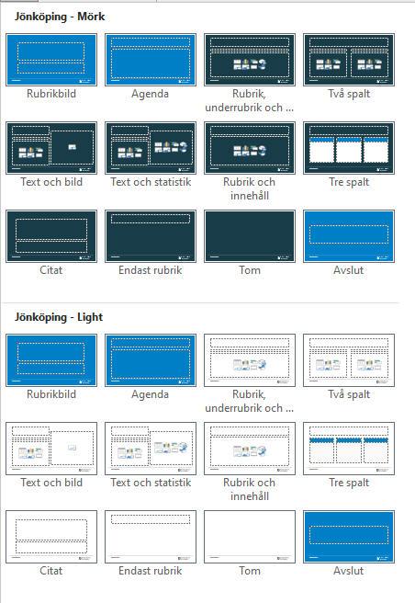
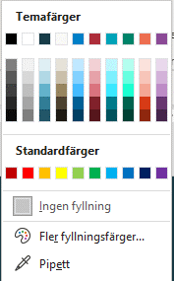
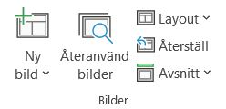
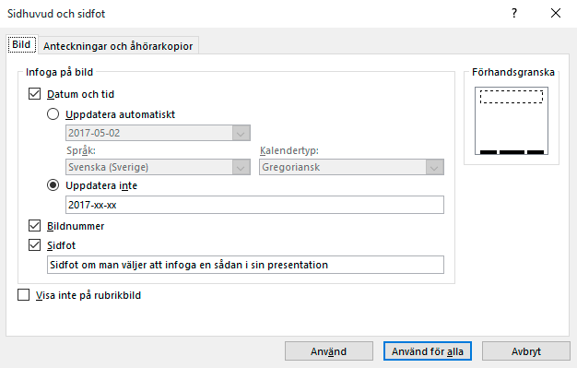
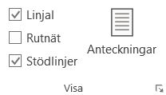
Instruktioner 1
Dold sida, visas inte vid utskrift
Mallsidor
Temafärger
Sidhuvud och sidfot
1. Ny bild, visar samtliga layoutsidor.
2. Layout, byter befintlig sidas utseende.
Befintliga layouter i mallen
Objekt färgsätts med de inringade färgerna som följer er grafiska profil.
Under fliken Infoga välj Sidhuvud och sidfot. Ändra i dialogen som du önskar och klicka på knappen Använd för alla för att använda på samtliga sidor med sidfot i presentationen eller Använd om du endast vill ändra i den sidan du står på.
Layouterna Rubrikbild, Agenda och Avslut ska endast användas för dessa ändamål. Det vill säga Rubrikbild som startbild, Agenda för agenda för presentationen och avslut som slutbild i presentationen.
3. Återställ, bilden visas i ursprungligt utseende. Används tex. för att få tillbaka punktlista om man tagit bort punkten.
Använd inte de inbyggda standardfärgerna.
Stödlinjer
Kontrollera att objekt och text är placerade innanför sidans marginaler. För att visa marginaler och stödlinjer, klicka på Visa och kryssa i rutan Stödlinjer (eller tryck Alt + F9).

Slide 2
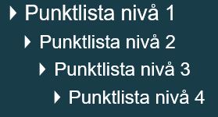
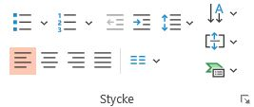
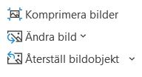
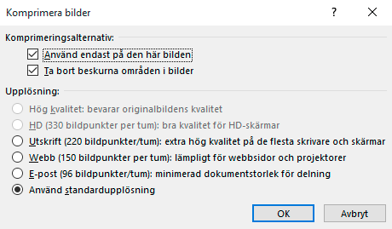

Instruktioner 2
Dold sida, visas inte vid utskrift
Punktlista och format
Bilder
De olika formatnivåerna som finns i mallen.
Använd inte dessa funktioner för att göra punktlista eller numrerad lista.
Om filen blir för tung och du vill minska storleken så välj en bild och klicka på Komprimera bilder.
Viktigt! komprimerade bilderna går inte att återställa. Bilderna måste läggas in
på nytt.
För att ändra nivån på format så klickar du på Öka/Minska indrag alt. Tab/Shift+Tab.
Om du önskar göra detta på alla bilder så klicka ur Använd endast på den här bilden.
Klipp och klistra
Bäst brukar vara att kopiera och klistra in enskilda objekt.
Tänk på att formatet från den gamla mallen/presentationen kan skilja sig åt och därför kommer det fungera olika. PowerPoint försöker alltid anpassa sig till den nya layouten men beroende på likheten mellan gamla och nya så fungerar det olika bra.
Använd alltid platshållare där det finns möjlighet.
Välj upplösning.

Slide 3
Welcome to the
Municipality of Jönköping!

Slide 4
Contents
Who we are in words and figures
Politics and organisation
Labour market and industry
A municipality focused on the future
The data and statistics have been obtained from the City Office Survey Unit and Statistics Sweden. Unless stated otherwise,
all the statistics are from 2022.
Notes:
Det här är vår övergripande kommun-presentation.
Den kan ses som ett stöd till dig som ska presentera kommunen - eller som en mall för att skapa en agenda.
Denna bild är inte nödvändig att ha med i själva presentationen.
SÅ HÄR ANVÄNDER DU PRESENTATIONEN:
Följ befintlig presentations struktur och upplägg.
Om du vill ta bort, dölja eller lägga till sidor går det bra – men ändra helst inte ordningen.
Om du vill lägga till fler kapitel/bilder finns det färdiga layouter att utgå från i de dolda bilderna på sida 3 och 4. Du hittar även fler layouter genom att infoga en ny sida vid pilen – under ”Ny bild” i menyn.
Om du vill infoga ett foto bakom balken (den blå sidfoten längst ner på varje sida), högerklicka på bilden och välj ”Formatera bakgrund”. Som fyllning väljer du ”Bild eller strukturfyllning” och sedan ”Infoga bild från fil”.
Lycka till med din presentation!

Slide 5
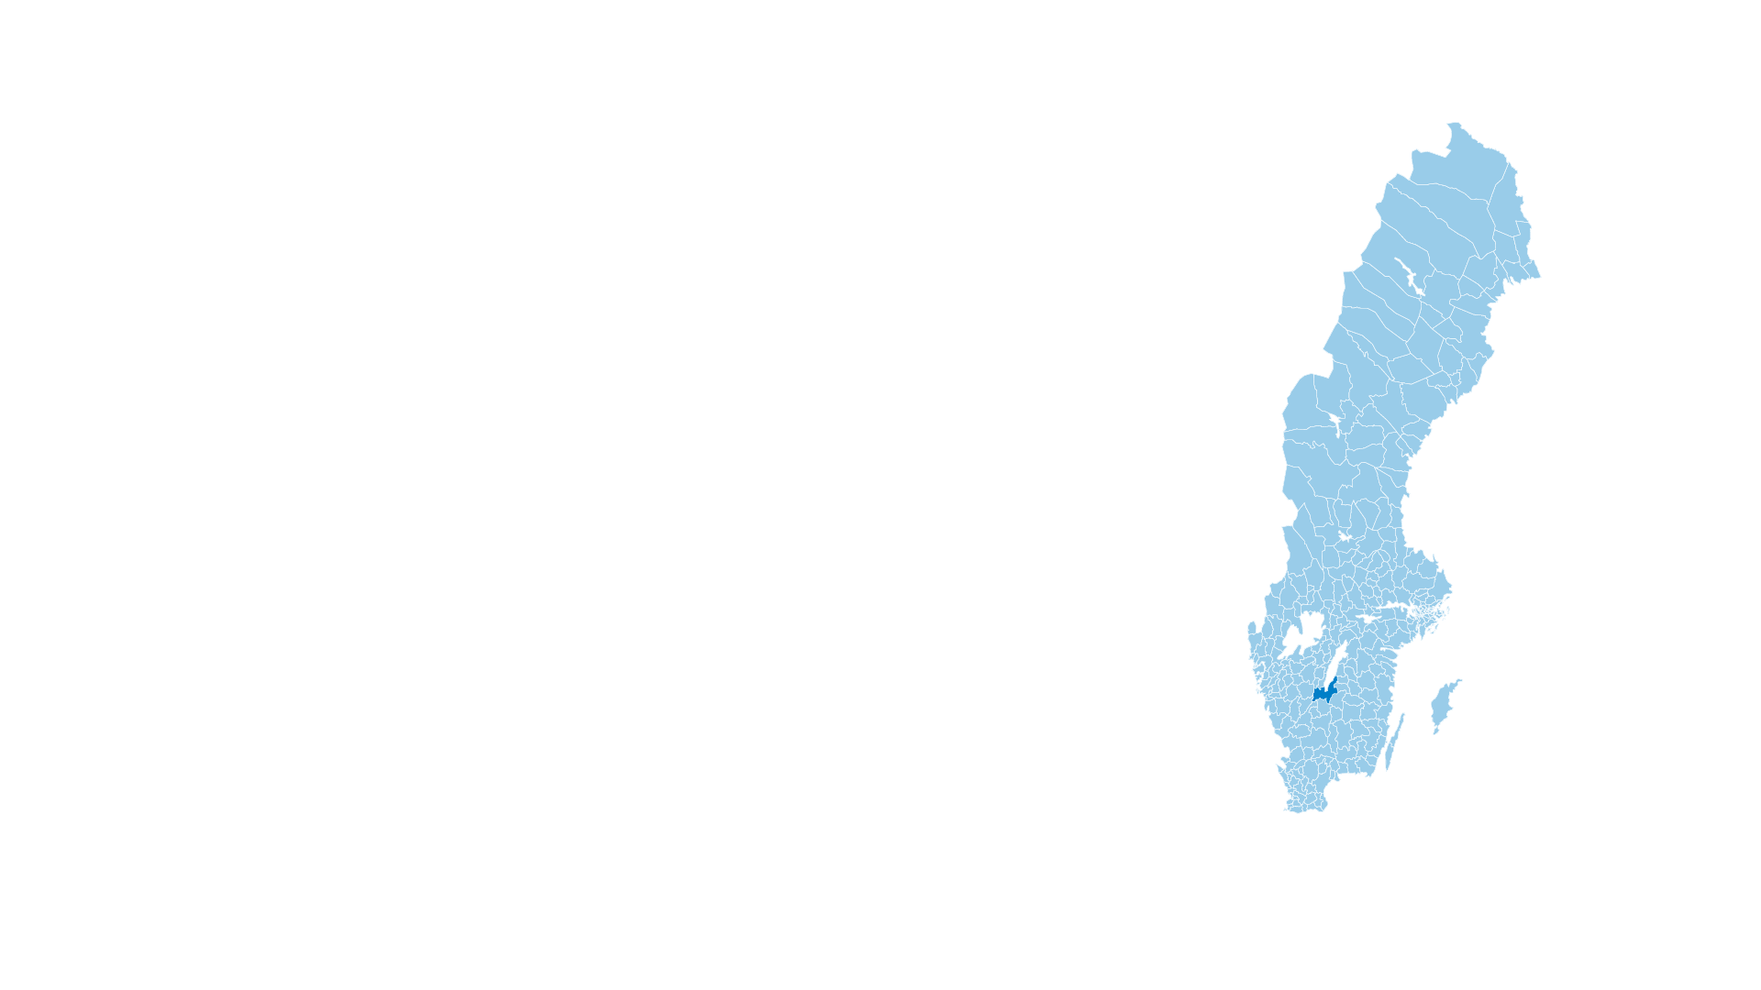
Good to know before we start
290 municipalities
Examples of responsibilities:
Schools, social services and eldercare
Municipalities are legally obliged to provide some services, while others are optional and decided
by local politicians.
Notes:
Municipalities are responsible for most of the social services available where we live. The most extensive services include schools, social services, and care for the elderly. Municipalities are legally obliged to provide some services, while others are optional and decided by local politicians.
The municipality has the right to make independent decisions and tax citizens to finance it’s activities.

Slide 6
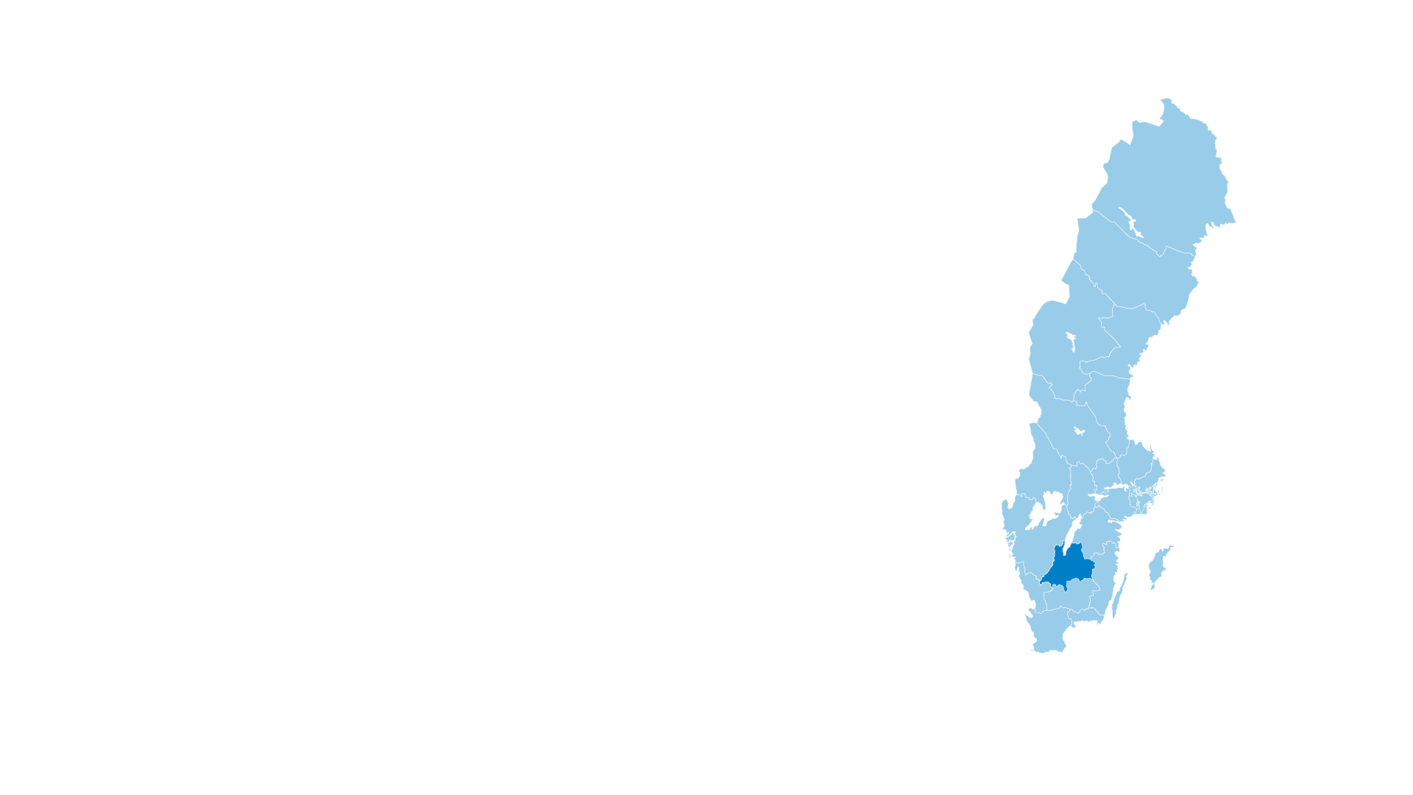
Good to know before we start
21 county councils/regions
Examples of responsibilities:
Healthcare, dental care and public transport
Regions are county councils with increased responsibility for regional development and infrastructure.
Notes:
County councils and regions are responsible for services shared over large geographical areas and which often demand considerable financial resources. These include healthcare, dental care, and public transport. Voluntary activities include culture, tourism, and regional development. Regions are county councils with an extended responsibility for regional development.
Politicians in the municipal and county council are elected directly by citizens. There are municipal and county council elections every four years in conjunction with the parliamentary election.

Slide 7
Who we are in words and figures
Notes:
The Municipality of Jönköping is around 1,500 square kilometres in size – almost twice the size of the city of New York. It is an area of contrasts, transitioning between rural communities, towns large and small, dense forest, rich agricultural land, lakes, and watercourses. The Municipality of Jönköping is at the interface between town and country.
Jönköping, which is the largest urban centre in the municipality, received its charter back in 1284. The municipality also includes the historic town of Gränna, founded in 1652, and Huskvarna, which dates back to the 17th century but did not officially become a town until 1911. Lake Vättern and the large island of Visingsö are also part of the Municipality of Jönköping.

Slide 8
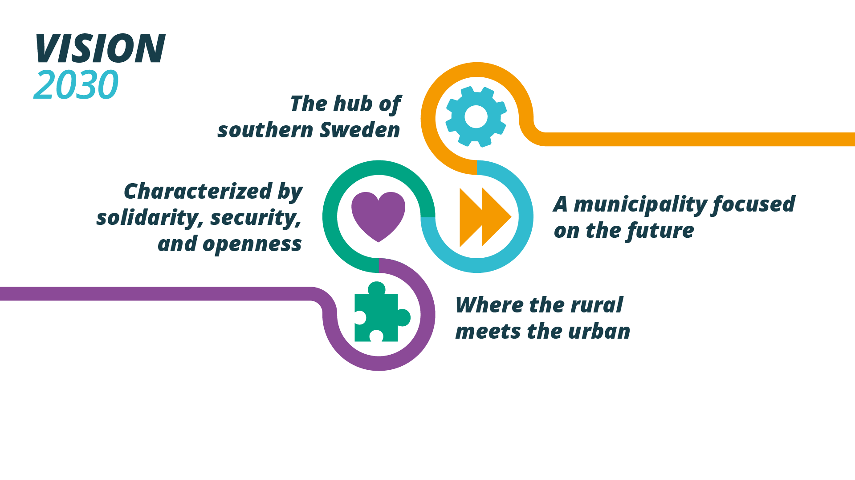
Vision 2030
Vision
Notes:
In February 2018, the Municipal Council adopted a proposal for Vision 2030, covering the whole of the Municipality of Jönköping. The vision highlights the importance of capitalizing on the unique characteristics and potential of the municipality. The starting point in the Vision is embodied in the aims for 2030. The Municipality of Jönköping is an attractive, welcoming place to visit, live in, and work – a place where people are happy; a place where they want to move to and remain. The Vision can be summarized in the form of the four target areas within which we are aiming to position ourselves through to 2030:
• Jönköping 2030 will be the hub of southern Sweden
• Jönköping 2030 will be a municipality focused on the future
• Jönköping 2030 will be characterized by solidarity, security, and openness
• Jönköping 2030 will be a municipality where the rural meets the urban
All development in the Municipality of Jönköping will be founded on ecological, social and economic sustainability, contributing to Jönköping 2030 becoming a sustainable, climate-smart role model.
Jönköping 2030 will be the hub of southern Sweden
Jönköping 2030 will be a hub with first-rate communications with the world. It will be convenient and environmentally friendly to travel to and from the municipality, generating greater potential for living and working there. Its strategic location, in combination with a broad, expansive industrial base, will be the obvious choice for companies seeking to establish or develop their operations. Jönköping 2030 has profiled itself as a hub for culture, sport, and outdoor life.
Jönköping 2030 will be a municipality focused on the future
Jönköping 2030 will be an open and positive municipality with an international character where we have the determination and initiative to invest and think along new lines. By capitalizing on the knowledge and commitment of the people living in the area, conditions will be created for promoting a sustainable municipality where ideas are developed and where we are not afraid to act. Initiatives throughout the whole of the education chain, from preschool to university, will form the foundation for a municipality symbolized by knowledge, innovation, and creativity.
Jönköping will be characterized by solidarity, security, and openness
Jönköping 2030 will be a large municipality with the community spirit, safety and security of a small municipality – a place where the opportunity to interact freely and productively with others, coupled with a strong civil society, will help to create a municipality for everyone. The municipality will also be permeated by openness, integrity, involvement, and accessibility. Jönköping will be a safe and secure municipality, regardless of where you are in life.
Jönköping 2030 will be a municipality where the rural meets the urban
Jönköping 2030 has vibrant rural areas and thriving green industries. People throughout the whole of the Municipality of Jönköping are proud of their rural landscape and heritage and there will be excellent opportunities to create a place to live, to make a living, and to take advantage of a rich and rewarding range of leisure and recreation pursuits. Jönköping 2030 will be a strong regional centre with a wide variety of shops, cafés, restaurants, culture, entertainment, and other activities. Everyone will have somewhere to live and there will even greater potential for more people to choose the Municipality of Jönköping as their home.

Slide 9
In 2030, the Municipality of Jönköping will be an attractive, accessible and welcoming municipality to visit, live in, and work – a place where people are happy and where they want to live and stay.
Jönköping is already a municipality that radiates success,
with consistent growth and expansion in every sector.
Notes:
It is a place where people want to reside and live their lives. As a municipality with a focus on the future we want to continue to develop together with those who live there. That is why we are being driven by the aims and ambitions set out in Vision 2030, making us one of the strongest city regions in the country. As the hub of southern Sweden, we are seeking to create a centre that is open yet secure. A place where people from town and country can meet, and with the potential to create and build for the future.

Slide 10
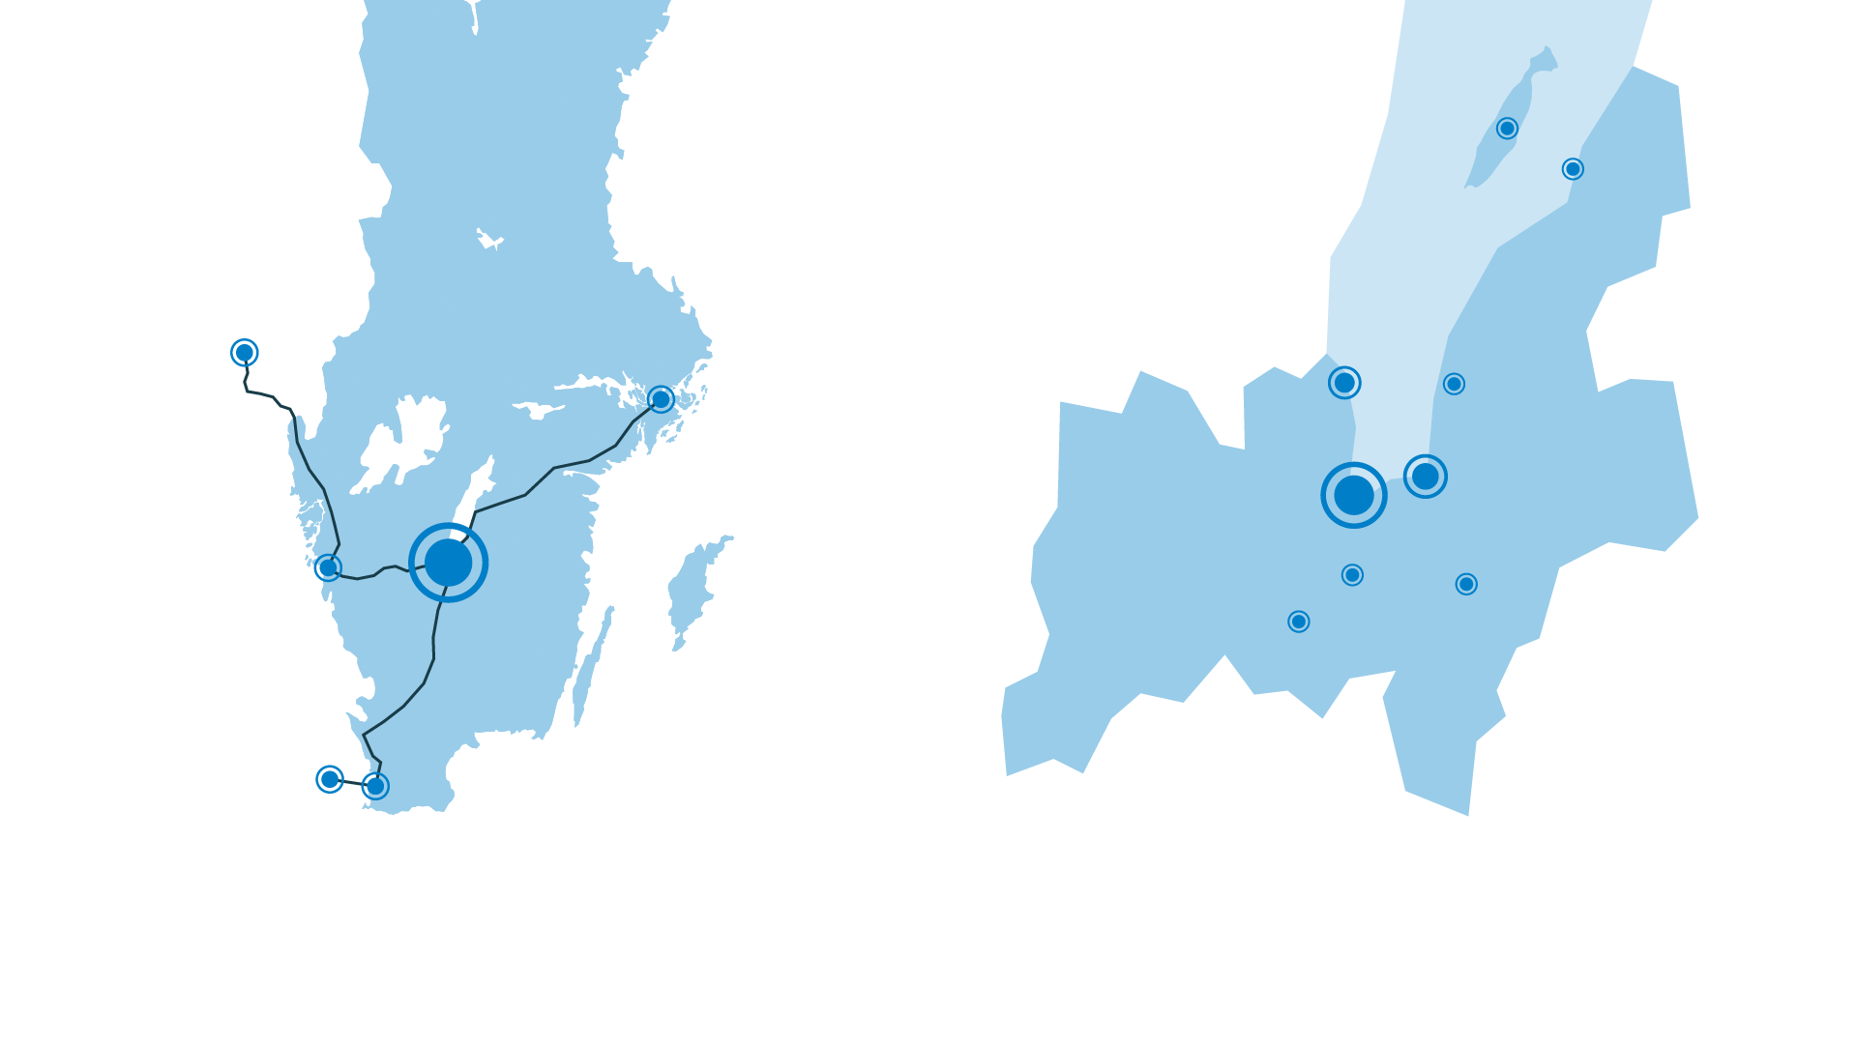
Hub of southern Sweden
Visingsö
Gränna
Oslo:
390 km
Stockholm:
320 km
Bankeryd
Kaxholmen
Jönköping
Huskvarna
Gothenburg:
150 km
Barnarp
Tenhult
Taberg
Copenhagen:
330 km
Malmö:
290 km
Notes:
We are a hub for southern Sweden, and we have excellent communications with the outside world – regardless of distance. The strategic location, in combination with our expanding industrial base, gives us the prerequisites for promoting innovation and maintaining a firm focus on the future. The location of our municipality in the heart of the Nordic region presents considerable communication potential with the rest of Sweden and the whole of Scandinavia.
Distances have been rounded off and are according to Google Maps (Shortest distance by car from the Town Hall in Jönköping to the centre of each town).
The largest towns and villages in the municipality of Jönköping are Jönköping, Huskvarna, Bankeryd, Taberg, Tenhult, Gränna, Barnarp, Kaxholmen.
The towns and villages in the Municipality of Jönköping are: Jönköping, Huskvarna, Norrahammar, Bankeryd, Taberg, Tenhult, Gränna, Barnarp, Kaxholmen, Lekeryd, Bottnaryd, Kortebo, Skärstad, Ölmstad, Örserum, Tunnerstad, Öggestorp, Gissebo, Ryd and Hulukvarn, Ulvstorp and Västersjön.
The Municipality of Jönköping is made up of 12 municipal areas: Jönköping, Huskvarna, Gränna, Visingsö, Skärstad, Lekeryd, Tenhult, Barnarp, Norrahammar, Månsarp, Bankeryd, and Norra Mo.

Slide 11

Increasing population growth
The 9th
largest
municipality
in Sweden
Notes:
We are the 9th largest municipality in Sweden and the home of 145 114 people. The municipal population has grown considerably. Over the past five years, it has increased by an average of 1 500 inhabitants per annum.
Many of us, 94 701, live in Jönköping and Huskvarna.

Slide 12
In-migration and out-migration
Net migration 2022:
+1 095
Net migration:
+1 298
Net migration:
+1 242
Net migration:
+879
Net migration:
+600
Net migration:
+1 095
Notes:
The Municipality of Jönköping comprises 12 municipal areas: Jönköping, Huskvarna, Gränna, Visingsö, Skärstad-Ölmstad, Lekeryd, Tenhult, Barnarp, Norrahammar-Hovslätt, Månsarp-Taberg, Bankeryd, and Norra Mo. Together we are an attractive place to live and develop and with a high net increase in population.
The population also changes in line with the number of births. In total, 1 526 children were born in the Municipality of Jönköping in 2022, and we had a net birth rate (births minus deaths) of 374.

Slide 13

Gender distribution and average age
40,5 years
Males: 39,5 years
Females: 41,5 years
Males:
73 099
Females:
72 015
Notes:
We are seeking to promote equality and create a municipality that is both inclusive and diverse. We are seeking to be a municipality with a community spirit and sense of security – where openness, interaction, and a strong civil society contribute to creating a municipality for everyone.
The average age in the municipality is 40.5 years – 39.5 years for men and 41.5 years for women.
The average age throughout Sweden is 41.7 years – 40.9 years for men and 42.6 years for women.

Slide 14


Education
Higher level of education:
44 %
Students at JU:
11,000
from 100 countries
Females: 50 %
Males: 39 %
Around 1,800 international
students each year.
Notes:
Higher education = post-high school education.
Progression into higher education in Jönköping: Average 44% – women 50%, men 39% (statistics from 2021).
Progression into higher education in Sweden: Average 43% – women 49%, men 37% (statistics from 2021).
11 000 students from 100 countries. Around 1 960 international students each year (18 %).
(This figure includes exchange students who stay for one or two terms, international students who follow a programme extending over several years, and students on foundation courses).
The whole of the education chain is vital to our present and future well-being and we are investing strongly in education – all the way from preschool to university. We are seeking to create a municipality symbolised by knowledge, innovation, creativity, and inclusivity.
Jönköping University is organised as a foundation, and it awards degrees at bachelor’s, master’s, and PhD level. Jönköping University comprises four specialist schools. The four schools are the School of Education and Communication, the School of Health and Welfare, Jönköping International Business School, and the School of Engineering.

Slide 15
Politics and organization
Notes:
Politics and organization

Slide 16
Political organization
Municipal Council
Election Committee / Municipal Audit Department
Municipal Executive Board
Advisory committees
Committees
Executive departments
Notes:
The Municipality of Jönköping is a politically governed organization just like all the other municipalities in the country. Political decisions are reached by the Municipal Council, the Municipal Executive Board, and 12 committees.

Slide 17
Advisory committees and comittees
Advisory committees
Committees
Management Committee (1)
Human Resources Committee (1)
Procurement Committee (1)
Welfare Committee (2)
Planning and Development Committee (3)
Election Committee (1)
Custodian Committee (1)
Crisis Management Committee (1)
Children and Schools Committee (2)
Education and Labour Market Committee (2)
Individual and Family Welfare Committee (2)
Accessibility Support Committee (2)
Eldercare Committee (2)
Environmental Health and Protection Committee (3)
Planning and Development Committee (3)
Public Works Committee (3)
Leisure and Cultural Services Committee (3)
Area of responsibility:
1. Management issues
2. Welfare issues
3. Urban development issues

Slide 18
Municipal Council and Municipal Executive Board
Municipal Council | 81 seats
Social Democrats (S) | 24 seats
Moderates (M) | 15 seats
Sweden Democrats (SD) | 12 seats
Christian Democrats (KD) | 12 seats
Centre Party (C) | 7 seats
Left Party (V) | 5 seats
Liberals (L) | 3 seats
Green Party (MP) | 3 seats
Municipal Executive Board | 15 seats
Social Democrats (S) Majority Coalition | 4 seats
Centre Party (C) Majority Coalition | 1 seat
Liberals (L) Majority Coalition | 1 seat
Green Party (MP) Support Party Majority | 1 seat
Left Party (V) Support Party Majority | 1 seat
Moderates (M) Opposition Coalition | 3 seats
Sweden Democrats (SD) Opposition Coalition | 2 seats
Christian Democrats (KD) Opposition Coalition | 2 seats
Notes:
Samverkan för Jönköping är ett resultat av förhandlingar mellan partierna för att bilda styre. Den politiska majoriteten består av Socialdemokraterna, Centerpartiet och Liberalerna i samverkan med Miljöpartiet och Vänsterpartiet.
Kommunfullmäktige fastställer de politiska målen för kommunal verksamhet. De beslutar bland annat om kommunens budget och ekonomi samt utser ledamöter till kommunala nämnder.
The Municipal Council has 81 members who are directly elected. The number of seats for each party is based on the election results.
Kommunstyrelsen leder och samordnar arbetet med kommunens övergripande mål, riktlinjer och styrning av den kommunala verksamheten. De bereder kommunfullmäktiges samtliga ärenden. De huvudsakliga uppgifterna är att ansvara för kommunens utveckling och ekonomi, översiktlig fysisk planering, mark- och bostadsförsörjning, näringslivs- och sysselsättningsfrågor, inköps-, informations- och turistfrågor samt organisationsfrågor.
Kommunstyrelsen har 15 ledamöter och 15 ersättare. Tre kommunalråd och två oppositionsråd leder och samordnar kommunstyrelsens arbete. Kommunalråd: Ann-Marie Nilsson (C), Andreas Persson (S) och Mona Forsberg (S). Oppositionsråd: Joakim Dahlström (M) och Anderas Sturesson (KD).

Slide 19
Eight Executive Departments
– with a total of 11,850 employees
Leisure and Culture Department
– 200 employees
Planning and Development Department
– 100 employees
Environmental Health and Protection Department – 50 employees
Central Administration Office
– 300 employees
Fire and Rescue Service
– 200 employees
Technical services department
– 800 employees
Social Services Department
– 5 000 employees
Education Department
– 5 200 employees
Notes:
We have eight departments with just over 11,850 permanent employees (around 13,500 if individuals on fixed-term contracts are included). They deal with day-to-day operations within all the areas covered by the municipal authority.
Our departments and their areas of responsibility are:
(The figures for the number of employees at the departments have been rounded off)
Leisure and Cultural Services Department – 200 employees
Recreation facilities, recreation activities, association support, activities for children and young people, and after-school centres. Responsible for the running of six heated swimming pools, as well as cultural activities open to the public, libraries, support for cultural associations, cultural environment conservation, public art etc. It also runs the Matchstick Museum and the Bird Museum.
Environmental Health and Protection Department – 50 employees
Monitors compliance with the Environmental Code and food legislation. Works with Agenda 2030 issues and is responsible for lakes and watercourses. Acts as a support body and advisory resource for the Municipal Executive Board and is responsible for liming and air quality measurement.
Fire and Rescue Service – 200 employees (about half of them are part-time employees)
Works with crime prevention, accident prevention, and crisis management and contingency planning. Accident prevention work includes fire safety, operational initiatives, fall prevention, suicide prevention, water safety, and road safety, as well as risk considerations in conjunction with physical planning. Responsible for the running of nine fire stations throughout the municipal area.
Social Services Department – 5,000 employees
Care of the elderly, individual and family welfare, health and medical care, and care of the functionally impaired. Around one in 10 inhabitants in the Municipality of Jönköping receive help from social services. Families and individuals receive advice, support, treatment, income support, and other forms of assistance under the Social Services Act. The Department also has overall responsibility for municipal eldercare services and welfare provision for the functionally impaired.
Planning and Development Department – 100 employees
Responsible for planning and construction matters, land survey matters, and traffic matters on behalf of the City Planning Committee. Develops and coordinates urban planning matters and the traffic infrastructure and runs development projects in the various urban centres within the municipal area. Also responsible for mapping and management of the municipal infrastructure.
Municipal Office – 300 employees
The central department in our municipality. Acts as the service body for the Municipal Council and the Municipal Executive Board. It is a strategic management and development resource for the whole of the municipality within finance, administration, development, HR, IT, communications, industry, procurement, and finance and companies.
Technical services department – 800 employees
Responsible for the functioning of the technical infrastructure, as well as buildings, land, nature areas, parks, streets, roads, water and sewage systems, and ferry traffic. It is also responsible for some of the waste management, ports, and parking, as well as planning of municipal housing and land provision.
Education Department – 5,200 employees
Covers operations from preschool to adult education and labour market matters. It is responsible for schools, family day care centres, preschools, high schools, special schools, the School of the Arts, adult education, and the UPPTECH science centre. It runs 95 preschools, 56 primary/secondary schools and 4 high schools within the municipal area.

Slide 20
Municipal companies
Municipality of Jönköping
Jönköpings Rådhus AB
Event companies
Housing companies
Energy and waste management companies
Property management companies
Other companies
Destination
Jönköping
Junehem
June Avfall
och Miljö
Högskolefastigheter
Jönköping
Airport
Elmia
Vätterhem
Jönköping Energi
Jönköpings kommuns Fastighetsutveckling
Södra Munksjön Utvecklings AB
Notes:
The municipality of Jönköping has established a group of wholly owned and majority-owned municipal companies with Jönköpings Rådhus AB as the parent company. There are ten companies in total, as well as a number of second-tier subsidiaries. The parent company, Jönköpings Rådhus AB, is responsible for the governance, supervision, and follow-up of all the companies in the group.
Destination Jönköping AB is charged with the task of marketing and promoting the development of the municipality of Jönköping as a tourist, event, and meeting point. Working in close collaboration with local hosts, associations, commercial enterprises, and industry, Destination Jönköping has developed a series of carefully formulated strategies to demonstrate that Jönköping has the scope and capability to be a world-class host. It has operational responsibility for Jönköpings Teater och Jönköpings Konserthus.
Elmia AB is one of the leading trade fair companies in the Nordic region, and each year it arranges trade fairs, conferences, congresses, and events for a whole range of business sectors. The aim of the company is to promote growth and development in the municipality of Jönköping and the surrounding areas.
Second-tier subsidiary: Näringslivets hus
Junehem AB is a housing company that owns and manages approximately 2 600 homes and about 20 000 m² of premises leased to businesses. Its mission is to provide housing in the suburbs and the countryside in Jönköping municipality.
Bostads AB Vätterhem is the municipality of Jönköping’s largest housing company. It owns, manages, and develops properties throughout the area. With 85,000 square metres of non-residential premises and over 8,900 apartments, it operates within the more urbanised areas in areas of Jönköping and Huskvarna in the municipality of Jönköping.
June Avfall & Miljö AB is jointly owned by the three municipalities Jönköping, Habo and Mullsjö. They conduct waste operations for each owner municipality. This means that they help approximately 163 000 municipal residents with waste collection, sludge emptying, and sorting yard operations. They handle 100 000 tonnes of waste from the municipality’s residents. A total of 1.5 million rubbish bins and 7 500 sludge bins are emptied per year. The company has about 100 employees.
Jönköping Energi AB is owned by the municipality of Jönköping and is part of a group made up of four companies. It provides 55,000 customers with lighting, power, heating, cooling, and urban utility networks. It is also responsible for generating power using local solar, wind, and water sources, as well cogenerated power. It offers a range of sustainable, innovative services, and is a major driving force for regional development.
- Second-tier subsidiary: Jönköping Energi Nät AB
- Second-tier subsidiary: Huskvarnaåns Kraft AB
- Second-tier subsidiary: NETSAM AB
Högskolefastigheter i Jönköping AB (HÖFAB) builds and manages premises for Jönköping University, and is responsible for 98,000 square metres of floor space and land area totalling 78,000 square metres. The company works closely with Jönköping University to create good, effective solutions for students and staff to meet changes in operating requirements. The company is partly owned (85.7%) by Jönköpings Rådhus AB. The remainder is owned by Jönköping University Foundation.
- Subsidiary: Campus Gränna AB
Jönköpings kommuns Fastighetsutveckling AB (JKPG Fast) satisfies the needs of the municipal authority, municipal inhabitants, and industry for land and commercial premises. It owns, manages, and develops properties. Its remit also includes contributing to the ongoing development of newly founded companies, as well as trade fair, event, conference, and cultural activities within the municipal area. The company owns a number of other companies, including Elmia, Hälsan 2 (Science Park House and Science Park Tower), the parking facilities Sesam, Per Brahe, Atollen, Smedjan, Biblioteket, Övertaget and Tändstickan and the subsidiary Jönköpings kommuns Fastighetsförvaltning AB, which has industrial premises at Industribyn Ljungarum.
- Second-tier subsidiary: Jönköpings kommuns Förvaltnings AB
Jönköping Airport AB operates and develops Jönköping Airport. Operations are divided into three main areas – regular traffic, charter traffic, and cargo traffic. In addition to commercial air traffic, Jönköping Airport has an important societal role to play as it is used regularly by planes operated by the firefighting, ambulance, and police services, as well military cargo planes, and planes used for organ transport. The company works actively with environmental and sustainability issues in a concerted effort to become a “Green Airport”.
Södra Munksjön Utvecklings AB (SMUAB) leads and drives the development of the new area of Södra Munksjön. This 300-hectare area will have 25,000 inhabitants, 11,500 workplaces, and large areas of land designated for commercial operations. The area will be an extension of Jönköping city centre and will become an attractive location for both residents and visitors with excellent communications and proximity to countryside, lakes, and rivers.

Slide 21
Municipal tax revenue is allocated as follows:
100 SEK in municipal tax (one SEK is equivalent to 1 % of the total budget)
Notes:
Our main source of income is the municipal tax that residents pay every month on their salaries. Together with government grants and tax equalization, it finances 80% of our ongoing activities, such as schools, libraries, museums, elderly care, roads, sports halls, parks, ports, etc. Everything that we, who live and have activities in Jönköping municipality, benefit from together (distribution in the picture is according to the financial statements 2022).
In 2022, we had a total of SEK 11,7 billion in revenue from our operations, taxes and government subsidies, and equalization. The tax rate for housing in Jönköping municipality in the income year 2023 is 33,658%.
Municipal tax: 21,64% + County council tax: 11,76% + Funeral fee: 0,258% = 33,658%

Slide 22
Labour market and industry
Notes:
Labour market and industry

Slide 23

Low unemployment rate
Municipality
of Jönköping:
5,1%
Sweden:
6,8%
Notes:
The rate of unemployment in the municipality is lower than the national average. We strive to create conditions for our inhabitants that offer them flexibility when choosing where and how to live.
The unemployment figures represent the proportion of the workforce aged 16-64 years in the Municipality of Jönköping who are unemployed.
Total: 5,1 %
Women: 5,3 %
Men: 4,9 %
Proportion of the workforce in Sweden aged 16-64 years who are unemployed:
Total: 6,8 %
Women: 6,9 %
Men: 6,7 %

Slide 24
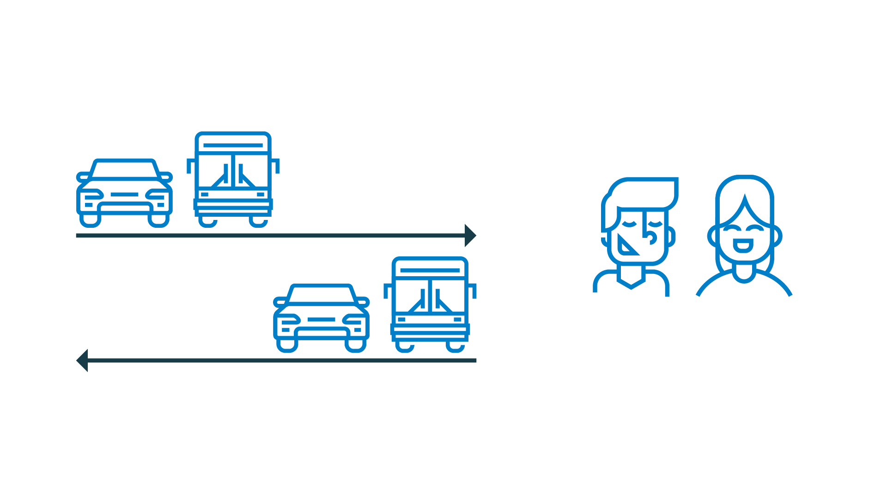
Large labour market region
Inward commuting:
15 721 people
Outward commuting:
9 439 people
79 429 people employed
Net commuting: +6 282 people
Notes:
We are the eighth largest labour market region in Sweden. Many people choose to commute here for work.
Inward commuting = people who live in another municipality but work in the municipality of Jönköping.
Outward commuting = people who live in the municipality of Jönköping but work in another municipality.
79,429 people employed = individuals aged 16 or older and who are in paid employment for at least one hour per week at a workplace within the municipal borders.

Slide 25

Wide range of sectors
Largest sectors:
Care and welfare | Retailing | Manufacturing and recycling | Corporate services | Education | Transport and storage
Large companies:
Husqvarna AB | IKEA | Kabe Group AB | SAAB | Kooperativet OLJA | Fläkt Woods AB | Elgiganten | PostNord | Arla Foods
13 700
companies in
the Municipality
of Jönköping
Public authorities and regional bodies:
Board of Agriculture | National Courts Administration | Forest Agency | County Administrative Board | Jönköping University | Ryhov County Hospital
Notes:
We have a total of 13,700 registered companies and organisations in the municipality. We have a large range of sectors with leading companies in logistics and transport, manufacturing, retailing, IT, and communications. We have an exhibition and trade fair centre at Elmia. Many people are self-employed. Our strength lies in having a mixture of companies. There are both highly innovative IT companies that have been recently started, as well as old-established industrial enterprises with a long and illustrious history. The development of the technology of the future takes place at companies old and new.
Largest employers in 2023, number of employees*:
Municipality of Jönköping – 15,325
Region Jönköping County – 7,625
Husqvarna AB – 1,925
IKEA – 1,275
Board of Agriculture – 875
Sesol AB – 725
Arla Foods – 675
SAAB Group – 675
Kooperativet OLJA – 675
Elgiganten – 625
KABE AB – 575
Swedish courts – 575
FläktGroup Sweden AB – 475
PostNord – 475
The police authority – 425
Jönköping University – 375
Samhall AB – 375
Vy Buss AB – 375
Source: SCB:s Business register
*) Employees are those who earn SEK 1,000 / month or more.

Slide 26

Typical Jönköping
Notes:
Before we continue, we can take a little break and have a look at some of the more unusual facts about Jönköping and the region.
Jönköping is sometimes known as the Jerusalem of Småland although it is not because we have lots of churches. The origin of the nickname goes back more than 160 years. In 1858, the rule that only ordained priests were allowed to hold prayer meetings was rescinded. In the wake of this momentous change, large numbers of free church members flocked to attend prayer meetings in the Jönköping area.
Pizza and kebab sauce are a winning concept, particularly in Jönköping. Our kebab sauce is so popular it even has its own Facebook page.
The classic peppermint rock candy Polkagris comes from Gränna. Dating back to 1858, we can thank confectioner Amalia Eriksson, who was the first to make the classic polkagris. There are seven polkagris producers in Gränna that are open all year round. The world polkagris-making championship is held in Gränna each year.
Dating back to the 17th century, the Husqvarna brand is very much a part of Swedish industrial history. Husqvarna built its first motorcycle back in 1903, and it is one of the oldest motorcycle brands in the world.
Jönköping is associated strongly with its dialect. Typical of many of those who live in Jönköping is the absence of the letter R in the pronunciation of various words.
There are only three matchstick museums in the world. Jönköping has one of them. The Matchstick Museum is located in what is known as the Matchstick District, and even today buildings still remain from the heyday of the matchstick industry. In 1844, brothers Johan and Carl Lundström started producing matches in Jönköping. In 1853, they switched from the highly dangerous phosphorus matches and began producing safety matches based on a patent held by researcher Gustaf Erik Pasch. The Lundström brothers also designed the match box that we know today, with its narrow side and a strip for lighting the match.

Slide 27
We are a municipality where our sights are set firmly on the future
Notes:
Our municipality is growing expansive, the digital infrastructure is developing, people and companies want to move here.

Slide 28

Expansive growth
It is estimated that by 2030
the municipality will have 155,00 inhabitants.
Notes:
The enormous rate of growth means that we are planning for the day when the municipality will have a population of 200,000.
The following are just some examples of how we are equipping ourselves to meet the future:
We have a record number of building projects in progress.
Several new preschools are being built and temporary measures are being taken by renting premises to ease the pressure in areas where more buildings are needed.
We are developing the Södra Munksjön area.
A long-term water and sewage plan with a vision, strategy and measures focusing on 2030.
Planning for a new high-speed rail link.
En ny översiktsplan tas fram som ska möjliggöra en hållbar utveckling så att kommunen kan växa till 200 000 invånare.
These are just a few of our plans designed to create an attractive municipal area for everyone.

Slide 29
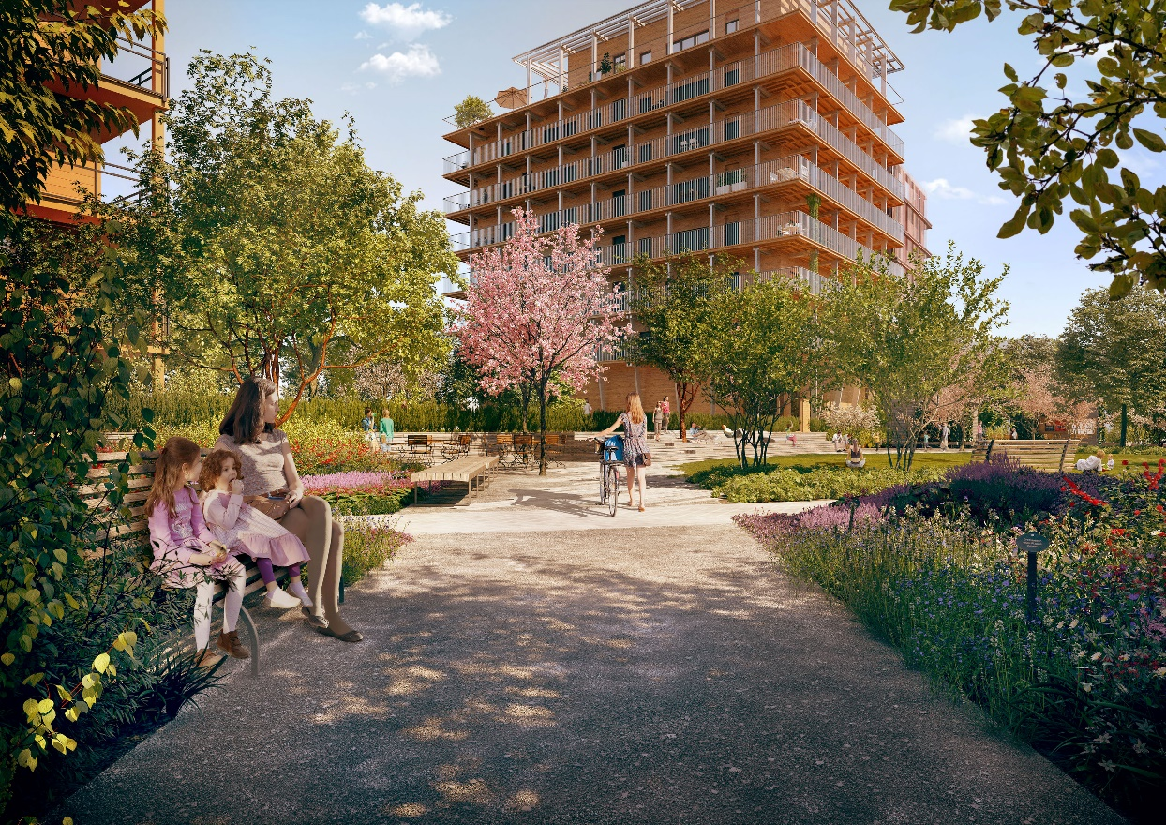
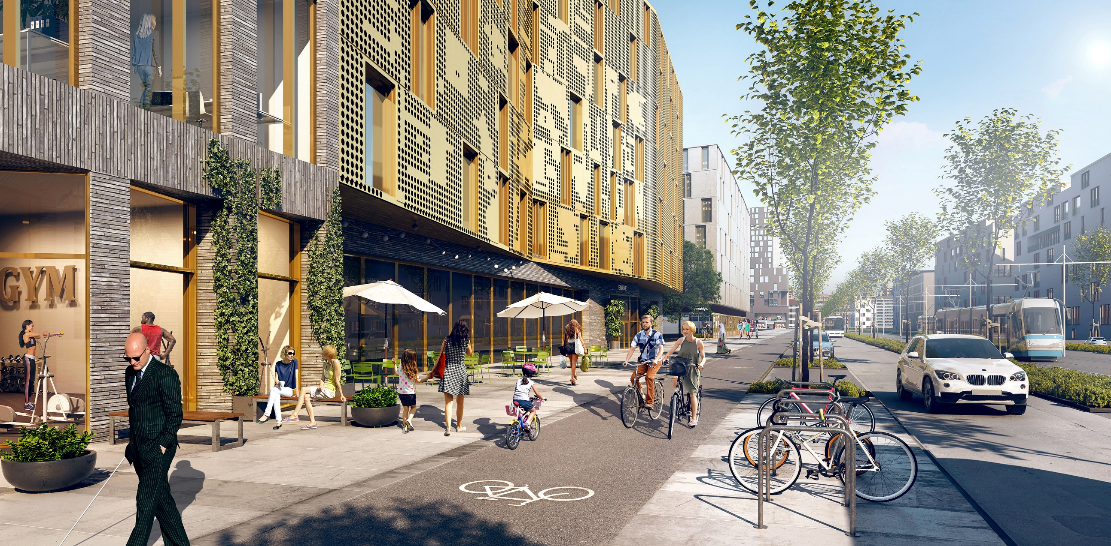
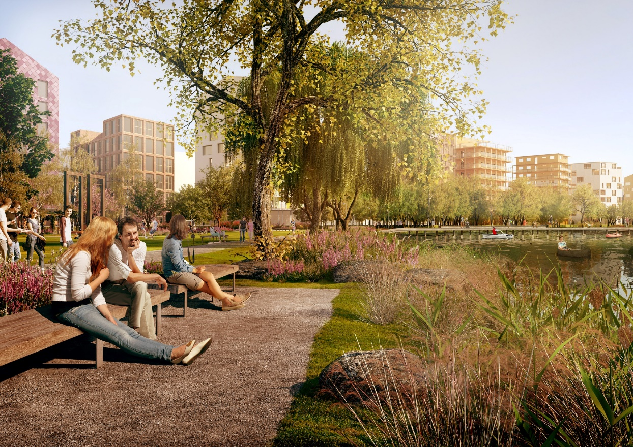
Södra Munksjön
– a new part of Jönköping
Notes:
The municipal-owned company Södra Munksjön Utvecklings AB has the remit of leading and running the development of the Södra Munksjön area. Södra Munksjön will become a place designed and designated for the people of the Municipality of Jönköping. With more districts and more homes in proximity to nature and water, we will create a new hub, brimming with life, people, and first-rate communications. In Urban Development Vision 2.0, we highlighted the Södra Munksjön area as the city’s new district. Following completion, the area will provide space for 25,000 residents, 11,500 workplaces, and 450,000 square metres of commercial premises.

Slide 30
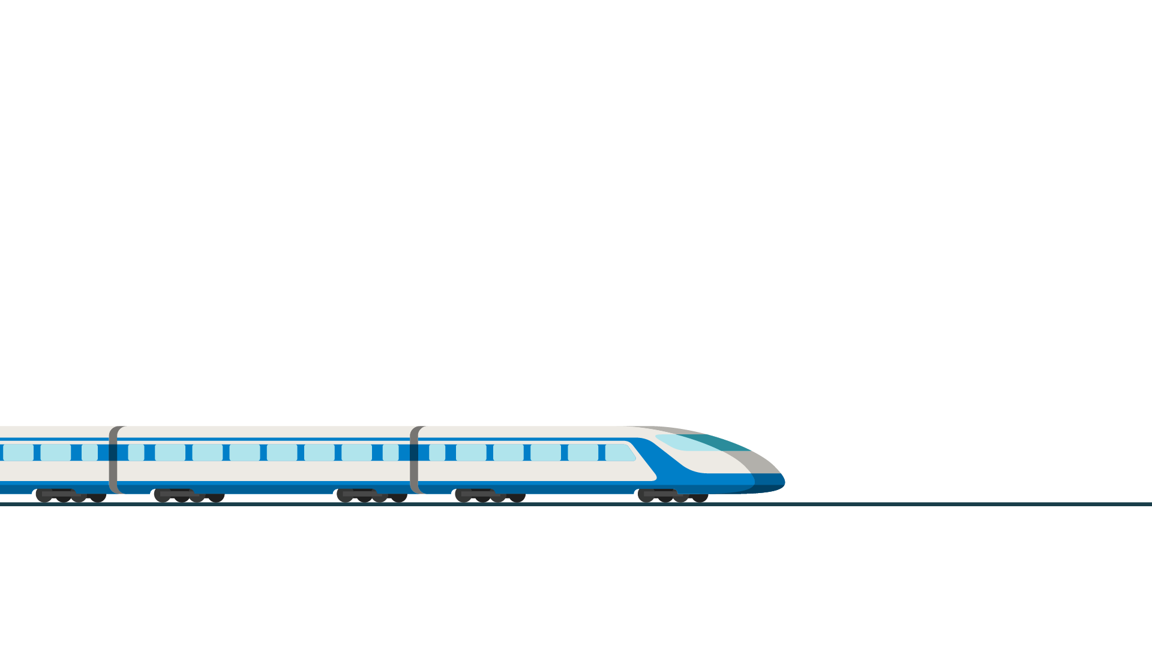
Hub of the future
Travelling times
Stockholm 1 h 30 min
Gothenburg 50 min
Malmö 1 h 30 min
Borås 40 min
Linköping 1 h
The new high-speed rail
link is planned to pass
through Jönköping.
Notes:
High-speed rail links are part of a wide-ranging infrastructure project which will create new opportunities for the people of the region. Thanks to the enhanced commuting potential that will be created, a new and expanded labour market will open up. We will grow and become an attractive municipal area, both to live in and to visit. It will also benefit commerce and industry.
The Södra Munksjön area will be the site of the station for the planned high-speed rail link. The station will be in an entirely new location, offering further opportunities for us to become a hub for the whole of southern Sweden.
Approximate travelling times by train at present:
Stockholm – 3h 30 min
Gothenburg – 2h
Malmö – 2h 50 min
Borås – 1h 10 min by bus (rail is not the best option)
Linköping – 1h 40 min

Slide 31
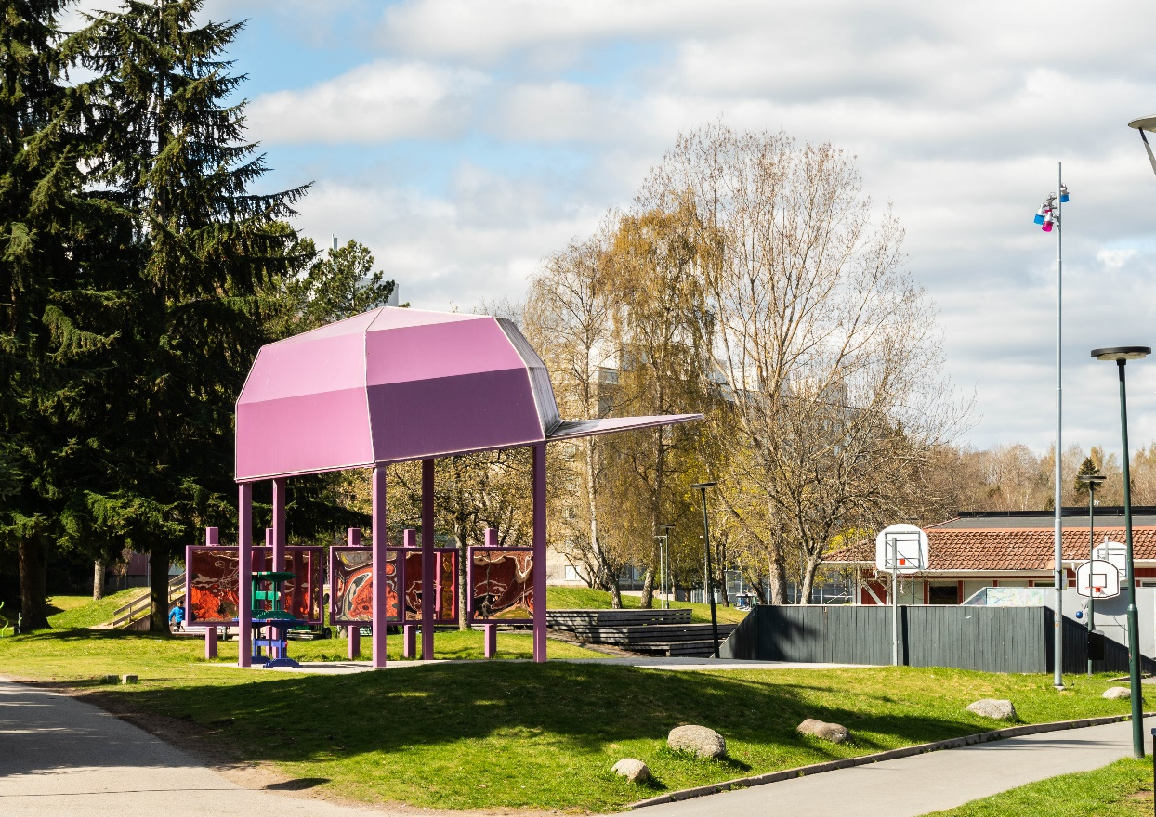
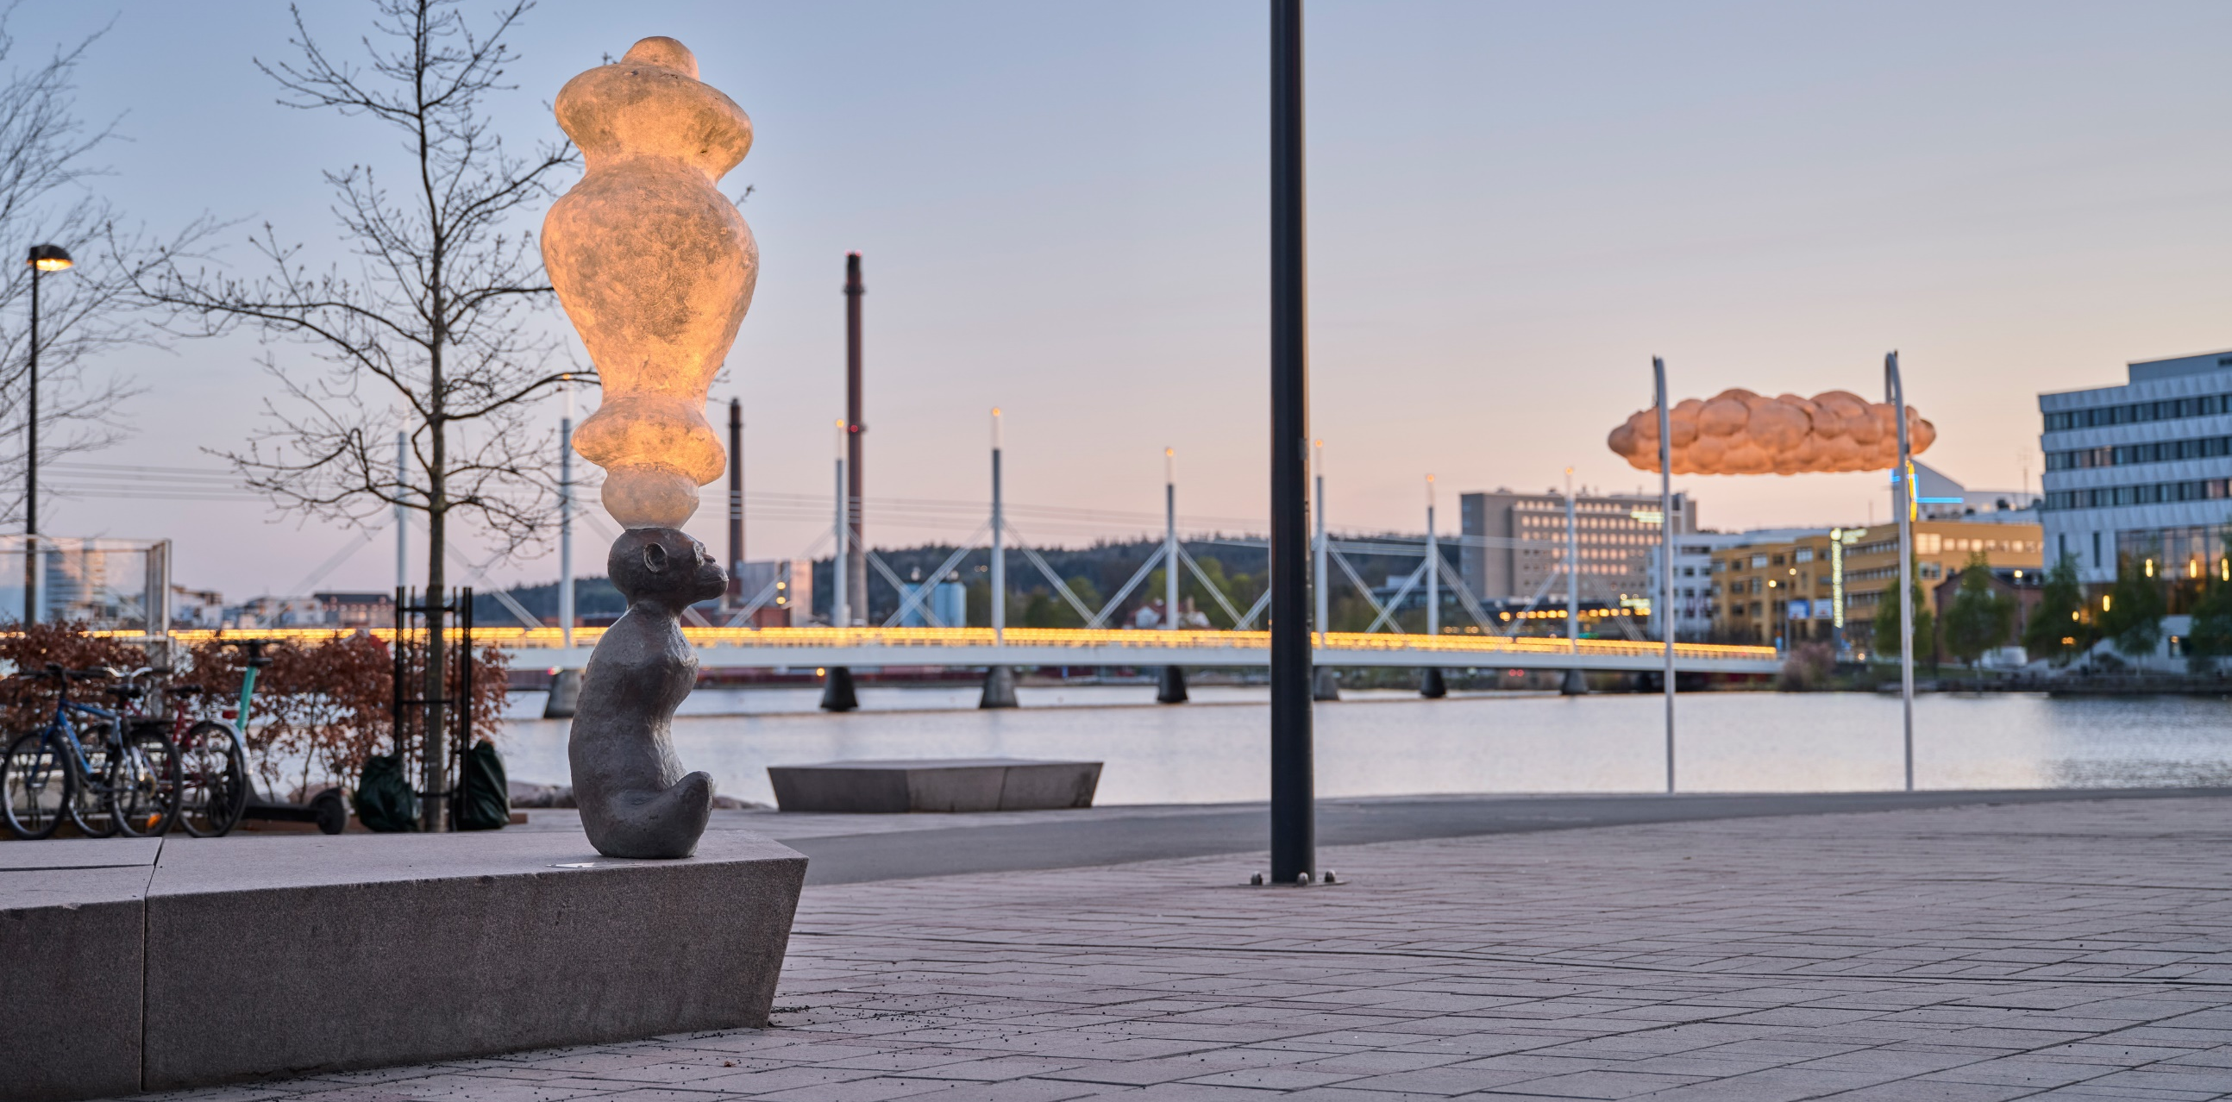

Urban meets rural
Notes:
Wherever you choose to live in our municipal area you will be close to the countryside and water. It is at the confluence of three lakes in what is a truly vibrant urban centre – and where city life and the countryside interact on a daily basis. There are arenas and meeting points for industry, associations, culture, and recreation. Both urban development and nature are multifaceted, and there is something for everyone.
A wide range of restaurants and cafés.
An extensive choice of concerts, performances, sports events, and forest walks.
Magnificent natural experiences that include the ‘shiny black mountain’ at Taberg with the opportunity to see a number of rare minerals and protected bat species.
Äppeldalen in Kaxholmen with its fantastic views across Lake Vättern, often nicknamed the Tuscany of Småland.
Brahehus, the ruins of the country residence of Count Per Brahe the Younger, located beside the motorway at Vätterbranten, is one of the most visited historical sites in Sweden.
Vätterstranden. A several-kilometre long sandy beach with large grassy areas in the very heart of Jönköping. Vätterstranden extends from Rosenlund in the east and a couple of kilometres west towards the city centre.
The Östra Vätterbranterna biosphere area. In summer 2012 it became a UNESCO-designated biosphere area. It offers tantalising forest meadows, trees in every shape and form, ravines, and ancient forest settings.

Slide 32
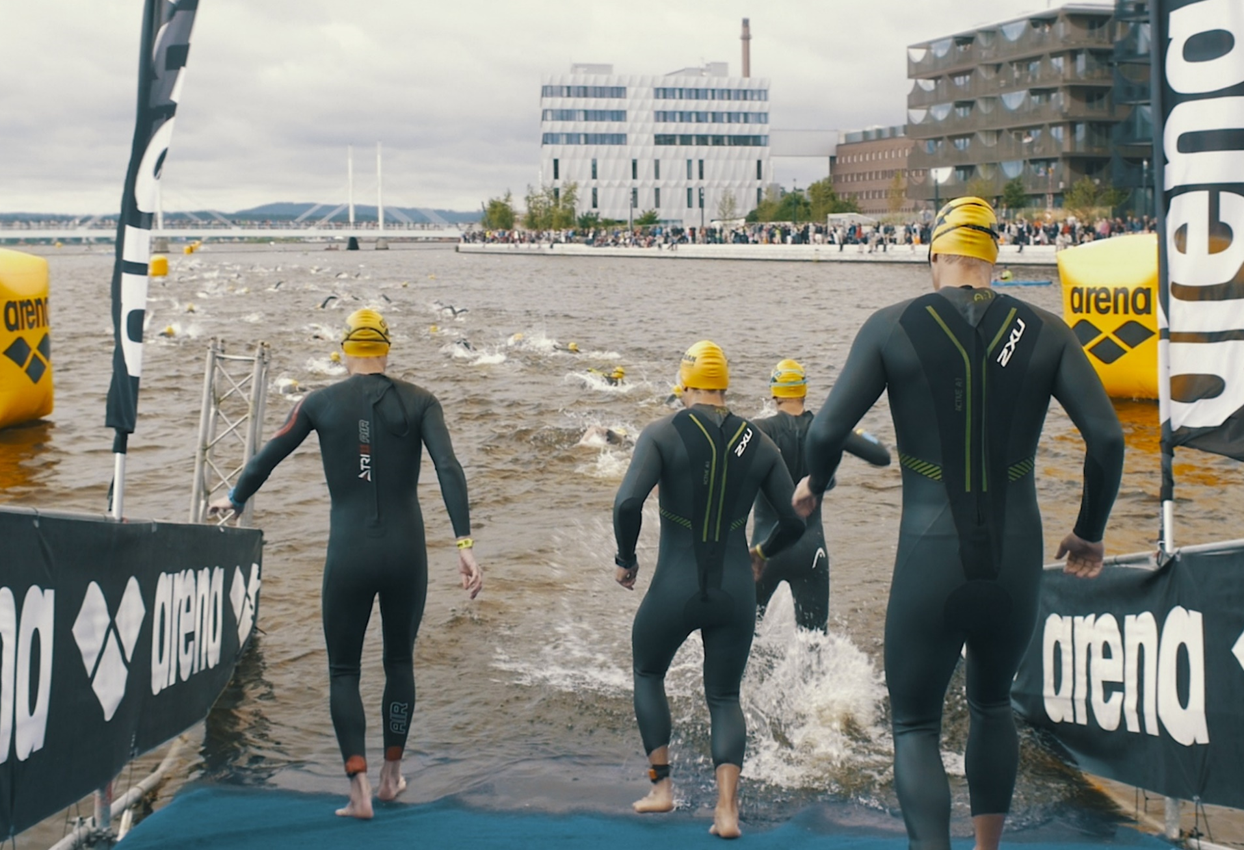
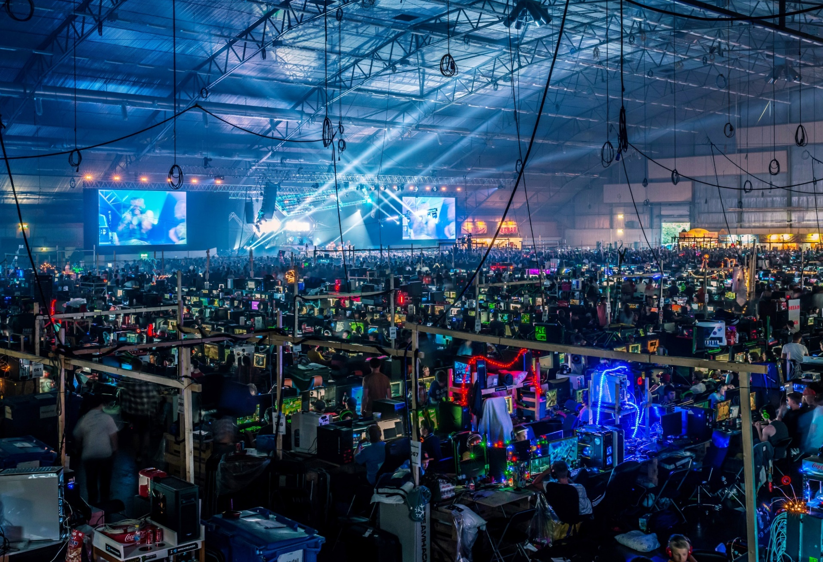
International and national events
Notes:
We are pleased to share our municipal area with others, and provide space and opportunity for activities, events and public festivities.
Ironman attracts more than 2,000 participants from all over the world.
DreamHack, the world’s largest computer gaming festival, is arranged twice a year and attracts around 50,000 gaming and e-sport enthusiasts.
Trade fair venue – we can proudly report that we are the arranger of one the world’s largest trade fairs in the forest products industry: Elmia Wood.

Slide 33
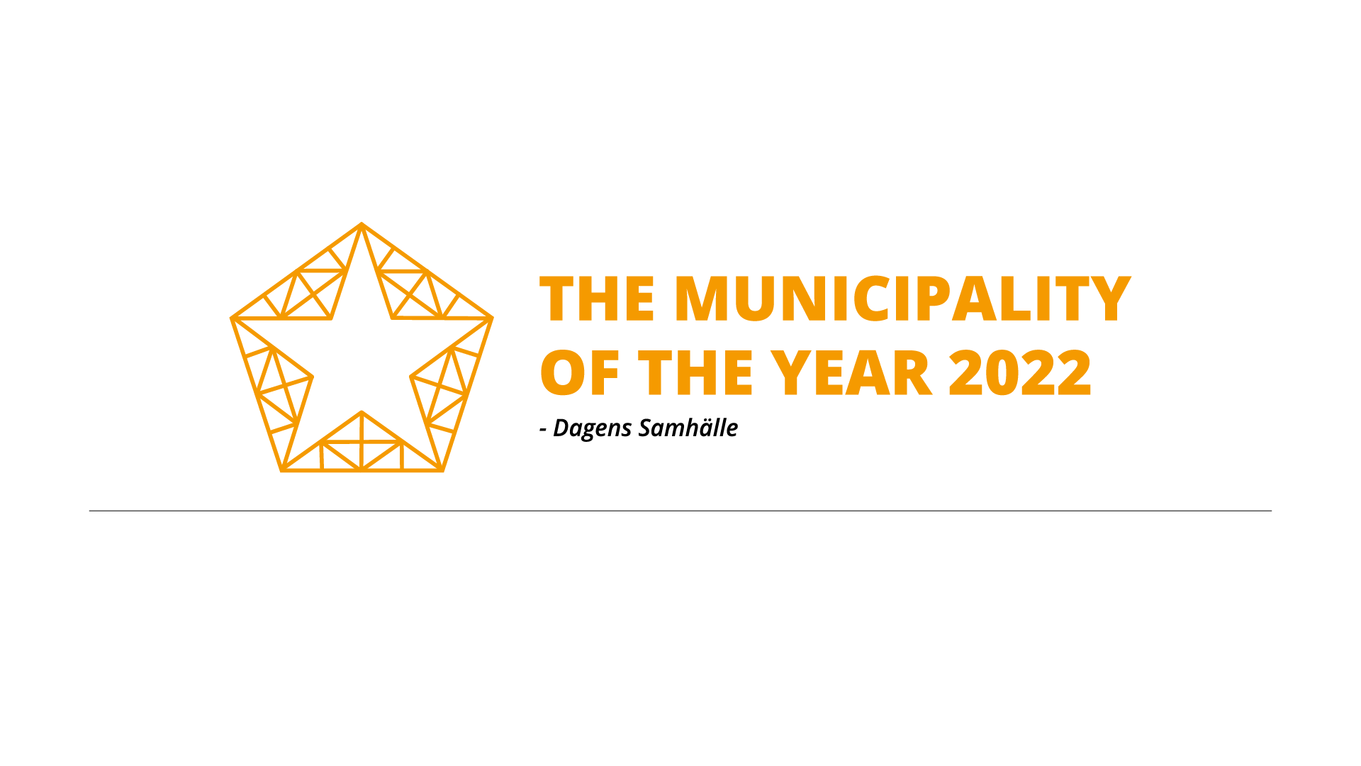
Prizes and awards
Access City Award 2021
European Commission
Top ranking in the citizen survey 2021
Statistics Sweden
Best employer among Sweden’s municipalities 2019
Universum
Notes:
We have a great deal to be proud of in the Municipality of Jönköping and it is not only we who think so. We have received several awards over the years:
Each year the European Commission presents the Access City Award to a European city that is seeking to improve accessibility for all its inhabitants. The winner for 2021 was Jönköping, which was awarded the prize for its work on creating equal access to the city for everyone, regardless of age or functional ability, and for developing working methods in which civil society has a vital role to play at every level. Apart from the award, there is a monetary prize of €150,000, which will be used to develop accessibility in a number of designated areas and throughout the city generally.
In Statistics Sweden’s citizen survey 2021, Jönköping Municipality’s results are above the national average in the majority of the survey’s questions. Overall, the results show that the municipal residents think that Jönköping municipality is a very good municipality to live in and that there are good opportunities for work and study post-secondary. A large proportion of those surveyed could also recommend others to move here. Security in the public environment also generally receives good grades, but in some of the issues concerning security in society, the results are at a lower level for women than for men.
Our municipality is ranked in the top 50 in the survey of Sweden's Best Employers, which is also top of all Swedish municipalities. The survey, conducted by the employer brand company Universum, measures what employees think about their current employer based on three different factors: internal identity, satisfaction and loyalty.
In 2019, Jönköping was named the city centre that has the best economic prerequisites according to a city survey run by the consulting company WSP. The survey covered 67 Swedish medium-sized and large city centres.

Slide 34
Thank you for listening!
Notes:
Thank you for listening!

